Slide 1
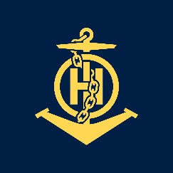
STATE HYDROGRAPHIC SERVICE OF GEORGIA
IHO – NIPPON FOUNDATION
ALUMNI SEMINAR
MANANA KIRTADZE

Slide 2
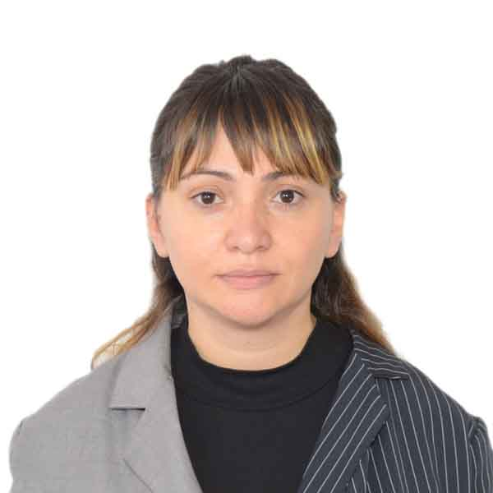
Self introduction
IHO – NIPPON FOUNDATION
ALUMNI SEMINAR
Name | Manana
Alumni year | 2016
Country | Georgia
Organization | State Hydrographic Service of Georgia
Position/Job title | Cartographer, Corrector
Current job description | Creation, producing and updating as ENs as Paper Charts.
Please put your photo here!

Slide 3
IHO – NIPPON FOUNDATION ALUMNI SEMINAR My career path and projects / Achievements
2008- Niko Nikoladze University of Georgia- Bachelors Diploma- Foreign language and Literature.
2011- Successfully completed consultation on practical application of dkart office software in electronic and paper navigational chart production.
2012- Course of Marine Navigation Cartography- Intellect Center Tbilisi, Georgia.
2012- Attended the European user Conference October 9-11, in Istanbul.
2013- Successfully completed of Jeppesen training in dkart Publisher and dkart Editor.
2015-Participated in Course on the Implementation of the COLREG 72 and IALA Standards.
2016- Completed the UKHO training course, CAT B Marine Cartography&data processing.
2017- Participated in the Workshop on Technical Aspects of Maritime Boundaries- Istanbul, Turkey.

Slide 4
IHO – NIPPON FOUNDATION ALUMNI SEMINAR My career path and projects / Achievements
Black and Azov Seas WG BASWG) Meetings
10th Meeting- Istanbul, Turkey (27-28 May 2010)
11th Meeting- Monaco (19-20 June 2013)
12th Meeting- Batumi, Georgia (3-4 June 2014)
13th Meeting-Istanbul, Turkey (3-4 May 2016)
14th Meeting - Constanta, Romania (3-4 May 2018).
Mediterranean and Black Seas hydrographic Commission ( MBSHC)
MBSHC -17- Athens, Greece (1-3 June 2011)
MBSHC- 18- Istanbul, Turkey (25-27 September 2013)
MBSHC- 19- Batumi, Georgia (30 June- 2 July 2015)
MBSHC- 20- Herceg Novi, Montenegro (4-6 July 2017)
MBSHC- 21- Cadiz, Spain (11-13 June 2019).
IHO ASSEMBLY
5th Extraordinary IH Conference, October 2014
1st Session of the IHO Assembly, April 2017.

Slide 5
My career path and projects / Achievements
IHO – NIPPON FOUNDATION
ALUMNI SEMINAR
During 2017 were compiled and produced following paper and ENC Charts
Compiled and produced following paper and ENC charts:
GE 101 1:10 000 _Batumi Port (new edition);
GE 105 1:100 000 _ From Port Batumi to River Enguri;
GE 100 1:50 000 _ Port Hopa to River Chorokhi;
GE102 1:50 000_ Georgia from River Supsa to River Chorokhi;
Compiled and produced new ENC Batumi Sea Port 1:5000;
Compiled and produced new ENC GE 101 1:10 000 _Batumi Port (new edition);
During 2018 were updated whole portfolio of Paper charts as well ENCs
Paper chart portfolio: GE11, GE 100, GE101, GE 102, GE103, GE104, GE105.
Electronic Charts: Port of Poti, Port of Batumi, Port of Kulevi and Coastline of Georgia.

Slide 6
Lessons learned from CHART Course
IHO – NIPPON FOUNDATION
ALUMNI SEMINAR
Basics of Cartography & Marine Navigation
Understanding Nautical Products and their use
S-57 Data Structure
Database Compilation and Update
ENC Production and Maintenance
Paper Chart Production (from Database) and maintenance
Source Data Assessment
Notices to Mariners Production.

Slide 7
Suggestion for the future
IHO – NIPPON FOUNDATION
ALUMNI SEMINAR
Constant communication with participants of the seminar in order to share experience;
Post-Seminar Follow ups (NIPPON FOUNDATION and Participants of the seminar);
Developing mechanisms to minimize errors during the production of charts and different publications;
Supporting participants of the seminar to improve compliance of products and services with the relevant international standards;
Discussion of new technologies/attending exhibitions (software/hardware) related to the production of charts.

Slide 8
IHO – NIPPON FOUNDATION ALUMNI SEMINAR
Thank’s for your attention!!!

